Slide 1
Greek text recognition by Neural Network
Ladislav Šulák (laco.sulak@gmail.com)
Krisztian Benko (kristianbnk@gmail.com)
Home university: Brno University of Technology, Faculty of Information Technology

Slide 2
Dataset
123 Greek characters per each class
Characters generated by Python script using 41 different types of fonts
Each image processed by 2 types filters (Dilation, Thinning)

Slide 3
Neural Network
Done by Neuroph Studio
30x30 image
4 layers (2 hidden layers – 86, 86)
24 outputs (Letters of Greek alphabet)
Multi layer perceptron
Activation function - Sigmoid

Slide 4
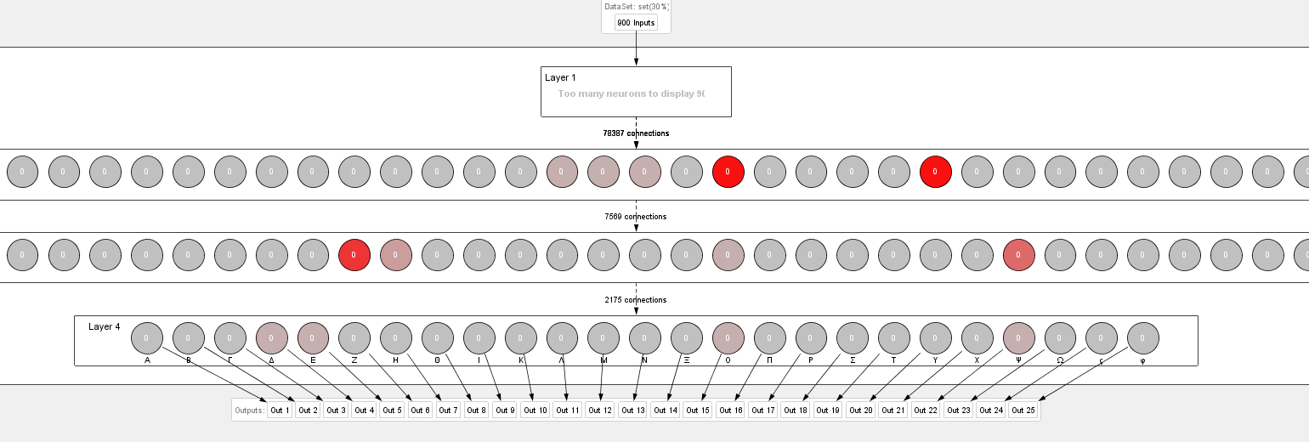
Neural Network

Slide 5
Training
500 epochs ~ 2hour
2975 images – 80% for training
Stopping criteria: iterations - 20 000 :D, max. error – 0.01
Learning parameters:
  Learning rate – 0.2
  Momentum – 0.7

Slide 6
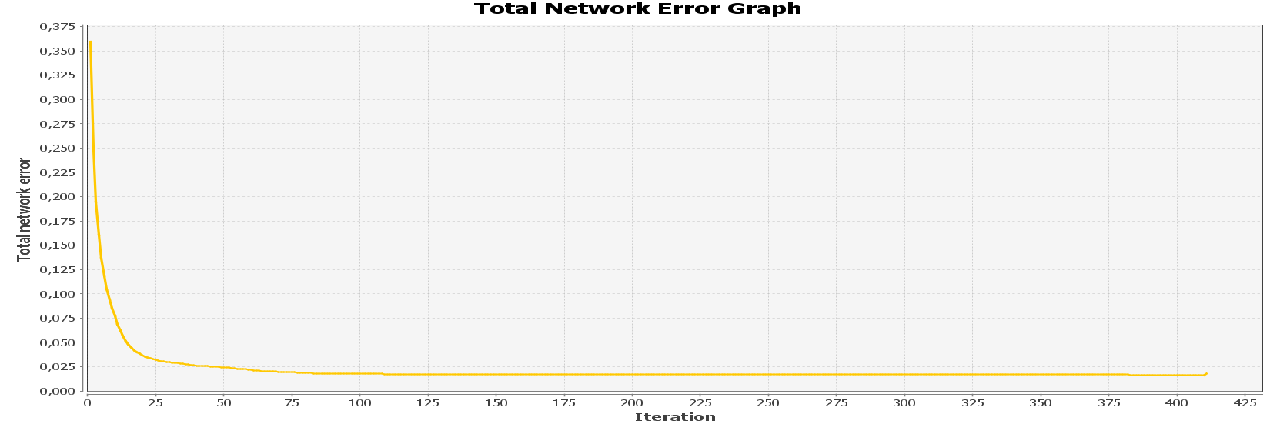
Training

Slide 7
Testing
20% of 2975 images

Slide 8
Neuroph plugin
BUG in Neuroph plugin 2.94 – bad version, instead 2.9 it is 2.8
Can not deserialize .nnet file
Used Neuroph plugin 2.92 in JAVA app

Slide 9
Future work – Text recognition
Text segmentation to lines – DONE
Text segmentation to words – Higher precision needed
Translation from Greek to English – DONE
Merging letters to words – TO BE CONTINUED…

Slide 10
Future improvements
Tuning, improving the data set
Split data set to lowercase and uppercase = 48 classes instead of 24
Tuning the parameters and architecture of ANN
Auto-correction
Android application

